Slide 1

Faculty-led institutional entrepreneurship
for inclusive business practices: Critical realist action research
Dr. Benito L. Teehankee
Jose E. Cuisia Professor of Business Ethics
Management and Organization Department
Ramon V. del Rosario College of Business
De La Salle University
benito.teehankee@dlsu.edu.ph
Notes:
Shared Prosperity: Promoting Equity and Growth
Schedule: October 27, 2021, 3:15 PM – 3:35 PM
Session Flow (20 minutes):
Introduction of Speaker by the host
15-minute presentation by Speaker and 5-minute Q&A

Slide 2
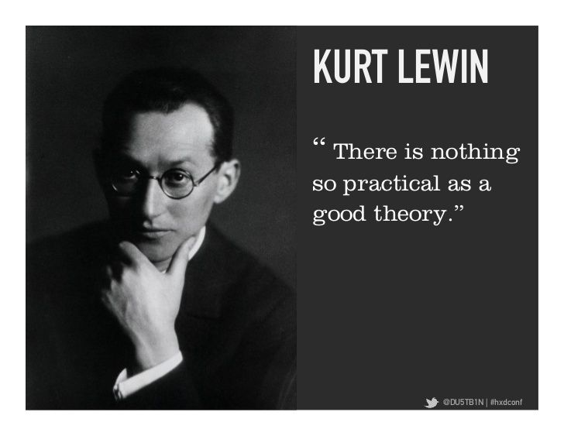

KURT LEWIN: FOUNDER OF ACTION RESEARCH

Slide 3
Understanding Action Research
Action research “seeks to bring together action and reflection, theory and practice, in participation with others, in the pursuit of practical solutions to issues of pressing concern to people” (Reason & Bradbury, 2001: 1).
Research and subject engagement: Subjects and researchers be jointly responsible for developing and evaluating theory to ensure that the results of inquiry (1) reflect the knowledge created through the participative process and (2) help improve the social situation of the subjects (Lewin, 1946)
Instead of viewing relevance and rigor as a dilemma, both are positioned as primary and interwoven criteria for quality research (Eden & Huxham, 1996).
Notes:
Lewin K. 1946. Action research and minority problems. Journal of Social Issues, 2 (4): 34–46.
Eden C. , Huxham C. 1996. Action research for management research. British Journal of Management, 7: 75–86.
Reason, P., & Bradbury, H. 2001. Handbook of action research. London: Sage.

Slide 4
Critical Participatory Action Research
CPAR is a form of action research that “expresses a commitment to bring together broad social analyses, the self-reflective collective self-study of practice and transformational action to improve things” (Kemmis, et al., 2014, p. 27).
CPAR has a long history of exposing the nature of disempowerment created in industrialized societies, and in recent times has incorporated an intersectional approach to understanding contemporary issues of injustice (Kemmis, et al. 2014; Torre, et al., 2011).
In this regard, its intersectional nature makes it an appropriate approach for dismantling systems and structures that foster exclusion.

Slide 5
Fig. 1.2 Action research cycle

Slide 6
Fig. 1.3 Spiral of action research cycles

Slide 7
Reflections and research questions
What is the role of a business academic in social change?
How can scholarly theory guide systemic change?
How can academics engage and collaborate with business practitioners in transforming business practice for the common good?
How can business students be prepared to practice business for social justice?

Slide 8
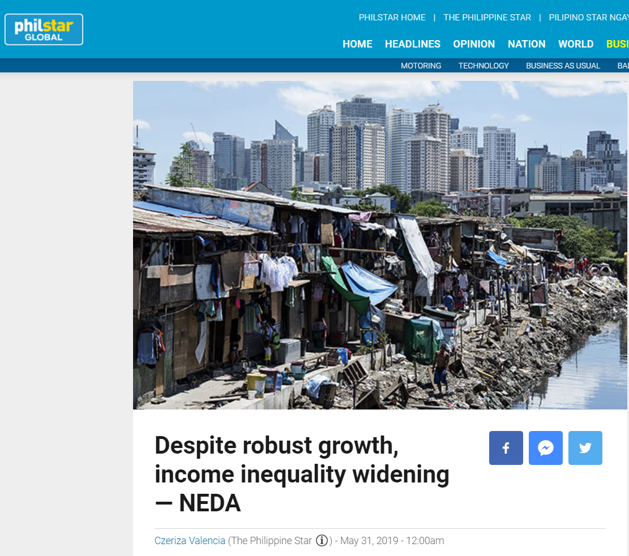


Slide 9
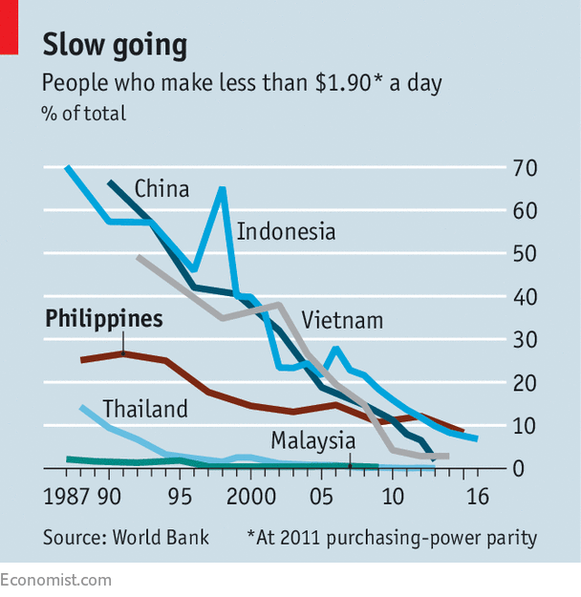
The country’s slow poverty reduction rate

Slide 10
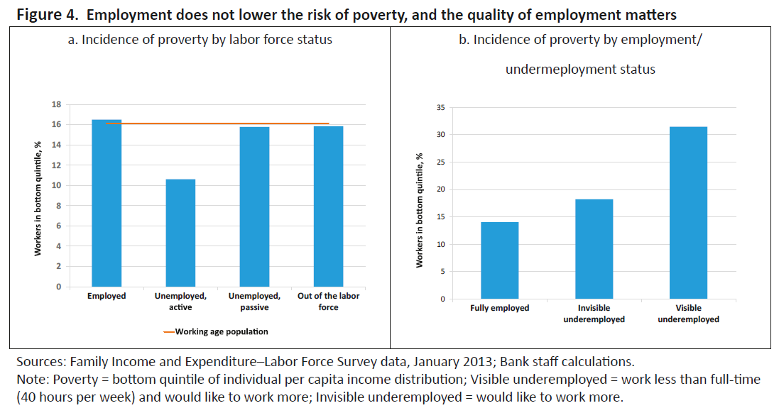

Slide 11


The challenge of inclusive growth in the SDGs

Slide 12
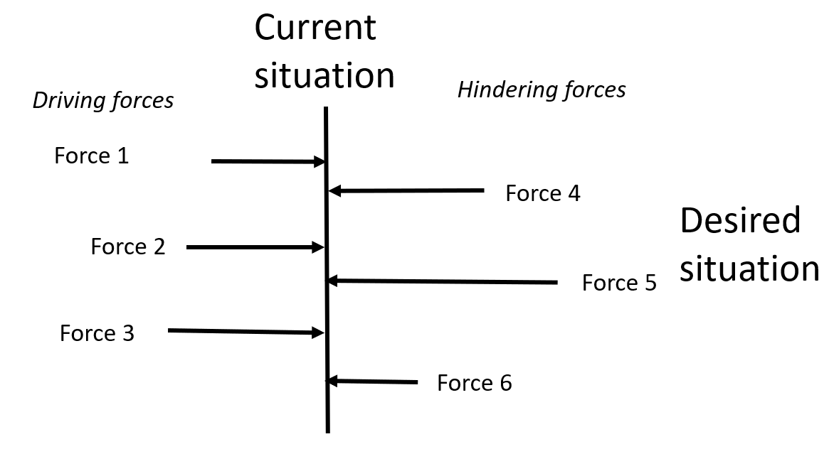
Developing a force-field diagram
In critical realism, a social situation is construed as being caused by multiple factors, including external material factors or forces (e.g., role pressures, physical events, etc.) and internal subjective factors (e.g., intentions, perceptions, priorities, emotions, etc.).
A force-field diagram helps action research collaborators and stakeholders in a situation to map their collective understanding (called “construction”) of a situation and the relevant multiple factors causing it.
This becomes a basis for their collective action to make the situation more emancipatory and promoting of personal wellbeing, as well as achieving practical goals.

Slide 13
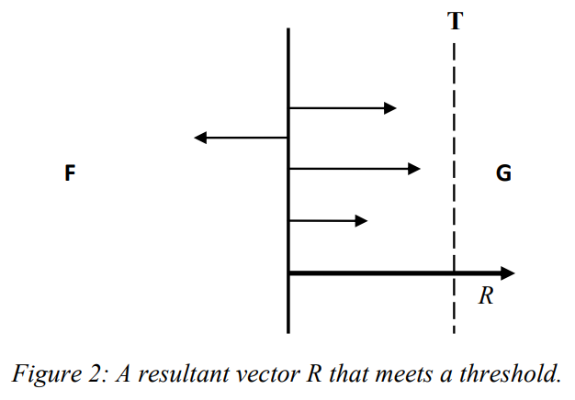
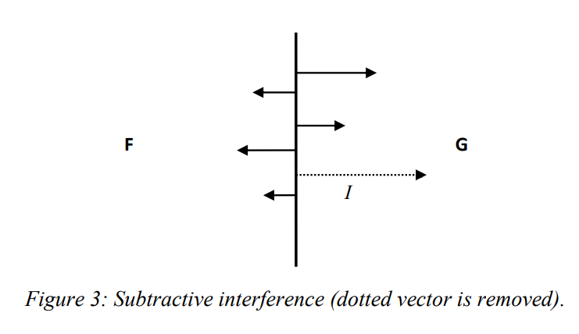
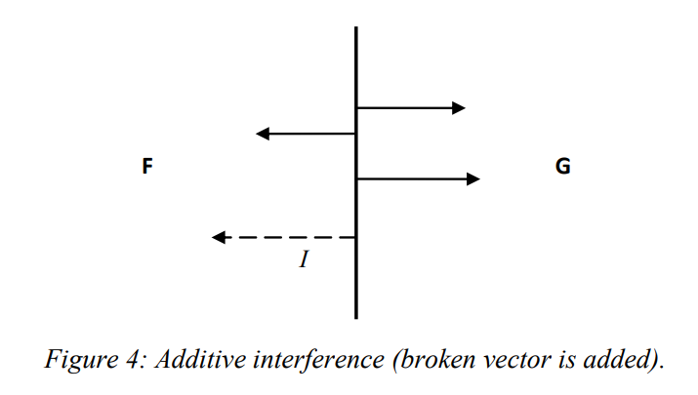
Mumford and Anjum causal vector model
Source: Mumford & Anjum – A powerful theory of causation

Slide 14
Causal model of inclusive business advocacy
Current
Situation: Dominance of
non-inclusive business practices
Mental: Reflexive beliefs of a few
prominent business leaders
Cultural propositions:
The duty of business is profit. Social duty belongs to government and personal advocates
Social: Global advocacies
towards inclusive practices
New regulations form SEC
Desired
Situation: Dominance of
inclusive business practices
Man-made: Technologically
enabled monitoring of corporations
Social structures:
Relationship of controlling shareholders
with employees
Relationship of top business leaders with the state
Action: Advocacy of
professional associations to
change regulations and management culture
Cultural propositions:
Corporate “owners” deserve
most of the gains, semi-feudal notion
Action: MBA curriculum reform
Adapted from Mumford & Anjum, Fleetwood

Slide 15
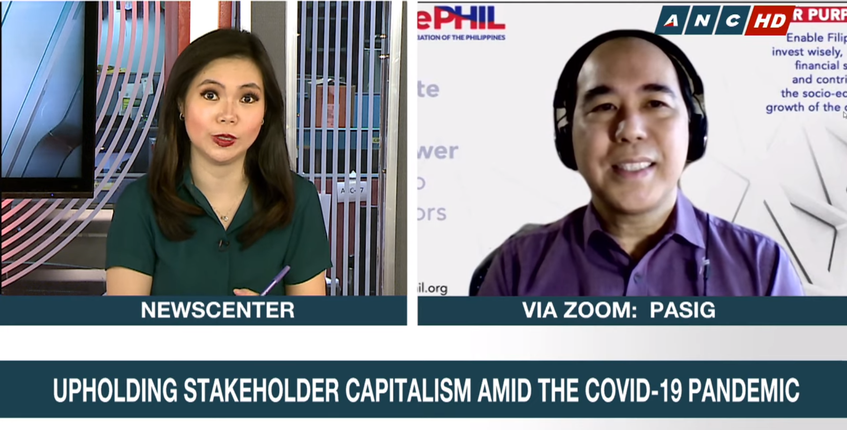
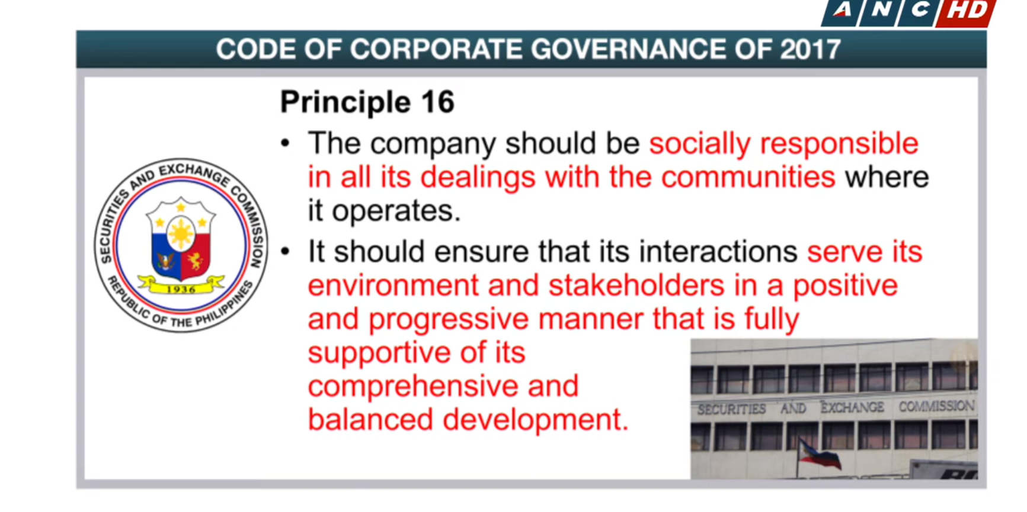
https://youtu.be/tldcgY5YQhc

Slide 16
Open Forum

Slide 17
Institutional entrepreneurship theory supplement

Slide 18
Non-inclusive business practice is institutionalized in the Philippines
Institutions are comprised of regulative, normative and cultural-cognitive elements that, together with associated activities and resources, provide stability and meaning to social life.
Institutions are distinctive in that
  they are relatively resistant to change, and
  they tend to be transmitted across generations, maintained, and reproduced. (Scott, 2008)

Slide 19

Institutional support for non-inclusive business practice
Non-inclusive business practices
Regulatory Pillar
Laws
Sanctions
Enforcement
Normative Pillar
Promotion of “good” behavior by professions and institutions
Cultural Pillar
People’s common ideas about “good and acceptable behavior”

Slide 20
Institutional entrepreneurship
Battilana et al. (2009)

Slide 21
The theory
The corporate field was ripe for change due to increasing regulatory oversight after high profile scandals in the West
As a faculty member, I had some social position and collaborated with my colleagues in DLSU. Insufficient in 2009 to effect policy change in the SEC.
I joined the Management Association of the Philippines (2009) and Shareholders Association of the Philippines (2014)

Slide 22








Non-inclusive business practices at the expense of other stakeholders
Investors
Government
Creditors
Capital
commitment
Fair &
attractive
returns
Funds
Taxes,
compliance &
cooperation
Repayment
& returns
Legal license,
infrastructure
support
& law enforcement
Maximize profit
Value through
products and
services
Oversight
Board
Performance
accountability
Value creating products
& services for human development
Managers
Customers
Suppliers
Provide better products
and services faster -- cheaply
Employees
Purchase &
patronage
Fair
compensation
and development
support
Work community meeting
human development needs of members while innovating and serving customers
Trustworthy
service &
behavior
Community &
Society
Company
Trust
Renewal
Resources
Current
Environment
Sustenance
Future
Renewal

Slide 23
Changing the Normative Pillar
Goal is to reorient business leaders towards inclusive business practices
Business school curriculum reform
  Requirement of Action Research in MBA Program (2012)
  Code of Ethics for Business adopted in DLSU business school (2014)
  Requiring course in Humanistic Management in De La Salle course in Applied Corporate Management (2019)
Professional organization advocacy
  Covenant for Shared Prosperity proposed and adopted by Management Association of the Philippines (2020)

Slide 24
Changing the Regulatory Pillar
Advocacy for change in corporate laws and rules
Collaboration with the Shareholders Association of the Philippines (SharePHIL)
Inclusion of stakeholders in Code of Corporate Governance (2009)
Adopted by the SEC in 2014 and then extended in 2017.

Slide 25
Changing the Cultural Pillar
Schools, associations, media need to debunk feudal ideas about property ownership as source of power and humans as instruments for profit maximization.
Business Columns: Manila Times “Managing for Society” (since 2005)
Media interviews: Stakeholder capitalism (2020)

